Slide 1

APTECH VISION - THE BIGGEST SOFTWARE EXHIBITION IN PAKISTAN
Aptech Vision is the embodiment of our vision for our students, which is to turn them into highly employable market-ready professionals. Acting as both a showcase and a marketplace for Human Resource & software solutions, this event is a testament to the efforts of students and their centers. This event now in its 8th iteration can be counted as one of the biggest software exhibition in Pakistan and is visited by university students, professionals, and other industry leaders. Last year over 210 projects were showcased, but it speaks volume when you consider that they were shortlisted from 1000+ projects created by Aptech students.

Slide 2
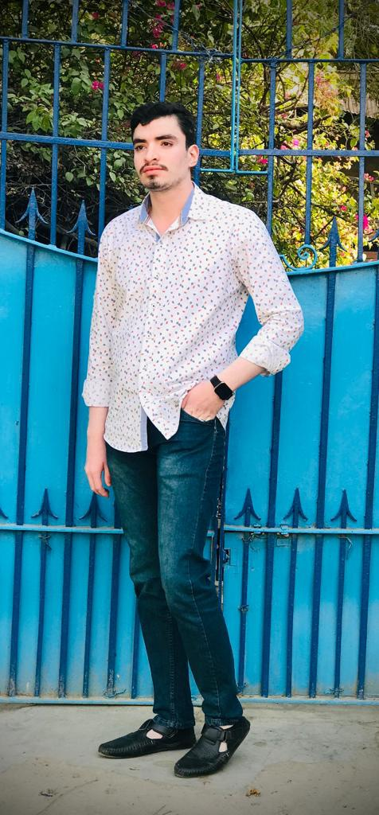
Project Prepared by: Mustafa 1347574
As per the define in APTECH Vision I also follow EXPLORING IDEAS FOR TOMORROW

Slide 3

Quick Calligraphy

Slide 4

Generation of Ideas
On 13 of March i generate ideas from my mind for how to work on the Quick Calligraphy

Slide 5

Header & Footer
On 14 of March I generate header & Footer of my website Quick Calligraphy.

Slide 6

Home Page
On 16 of March I generate Home page of my website Quick Calligraphy.

Slide 7

About Us Page
On 20 of March I generate About Us page of my website Quick Calligraphy.

Slide 8
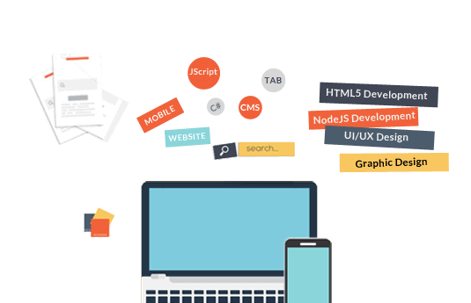
Services Page
On 23 of March I generate Services page of my website Quick Calligraphy.

Slide 9

Gallery Page
On 25 of March I generate Gallery page of my website Quick Calligraphy.

Slide 10


Contact Us and feedback Page
On 31 of March I generate Contact Us and Feedback page of my website Quick Calligraphy.

Slide 11


